Slide 1
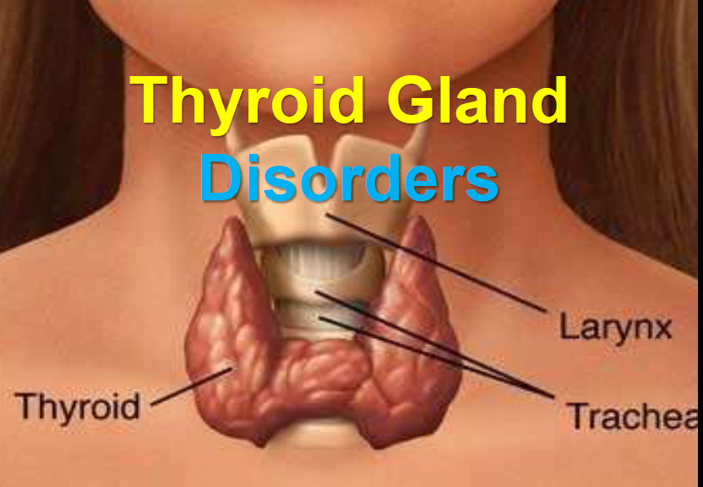

Slide 2
Thyroid gland
The largest pure endocrine gland (15-25 gm), located in the anterior neck
Consists of two lateral lobes connected by a median tissue mass called the isthmus.
The thyroid gland is made up of closely packed sacs called thyroid follicles (The structural and functional unit of thyroid gland with cyst-like structure).
Thyroid hormones are present in colloid bound to a large protein called thyroglobulin.

Slide 3
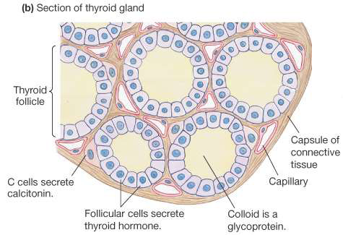
Thyroid gland

Slide 4
Thyroid gland
Thyroid gland secrets 3 hormones:
Thyroxin (T4)
Tri-iodotyronine (T3)
Main hormones secreted by thyroid gland
Secreted by follicular cells
Amino acid derivatives (tyrosine)
Calcitonin
Produced by parafollicular cells – C cells
It acts to reduce blood (Ca2+), opposing the effects of parathyroid hormone

Slide 5
Actions of thyroid hormones
Essential for proper fetal growth & development specially, CNS.
After delivery, their primary role is in regulation of energy metabolism. They can affect the function of every organ in the body.
Increase the body’s basal metabolic rate
Increase oxygen consumption.
Essential for normal growth and sexual maturation.
Increase the sensitivity of CVS and CNS to catecholamines (↑COP and HR).

Slide 6
Regulation of thyroid action
The production and release of thyroid hormones are regulated by the hypothalamic–pituitary–thyroid axis.
Hypothalamic thyrotropin-releasing hormone (TRH) stimulates the release of TSH when there are physiologically inadequate levels of thyroid hormones.
TSH promotes production and release of thyroid hormones.
As circulating thyroid hormone levels rise to needed levels, negative feedback results in decreased release of TSH and TRH.

Slide 7
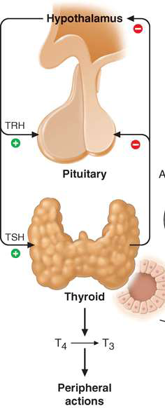
Regulation
Release of TRH is also inhibited by somatostatin and its analogs.
Release of TSH can be inhibited by dopamine, dopamine agonists, and high levels of glucocorticoids

Slide 8
Synthesis of thyroid hormones
T4 and T3 are produced by the organification of iodine in the thyroid gland.
TSH action is mediated by cAMP and leads to stimulation of iodide (I−) uptake by the gland.
Oxidation to iodine (I2) by thyroid peroxidase.
Iodine is covalently bound to tyrosine residues of thyroglobulin to give monoiodotyrosine and diiodotyrosine.

Slide 9
Synthesis
Condensation of two diiodotyrosine residues gives rise to T4 whereas condensation of a monoiodotyrosine residue with a diiodotyrosine residue generates T3.
The hormones are released when needed following proteolytic cleavage of the thyroglobulin.
Eighty percent of thyroid hormone is synthesized as T4 and is stored in the thyroid bound to thyroglobulin.

Slide 10
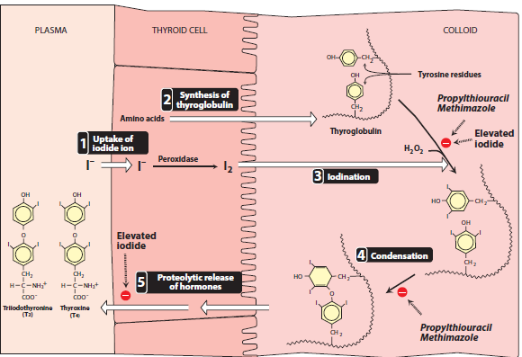
Synthesis

Slide 11
Mechanism of action
T4 and T3 are transported in the blood by three proteins, 70% bound to thyroid-binding globulin (TBG), 15% to transthyretin (thyroid-binding prealbumin), and 15% to albumin.
Only the unbound fractions of T3 & T4 physiologically active.
Most of the physiologic activity of thyroid hormones is from the actions of T3. T4 can be considered a prohormone.

Slide 12
Mechanism of action
T4 is enzymatically deiodinated to T3, which enters the nucleus and attaches to specific receptors.
The activation of these receptors promotes the formation of RNA and subsequent protein synthesis, which is responsible for the effects of T4.
Deiodinases catabolize T3 and T4 to biologically inactive metabolites (the major route of metabolism).
The hormones are also metabolized via conjugation with glucuronides and sulfates and excreted into the bile.

Slide 13
Spectrum of thyroid disease
There are two general modes of presentation for thyroid disorders:
Changes in the size or shape of the gland.
Changes in secretion of hormone from the gland.
In some cases, structural changes can result in changes in hormone secretion.
Thyroid nodules and goiters are common problems.
Changes in hormone secretion, often due to inflammatory disorder (thyroiditis), can result in hormone deficiency or excess.

Slide 14
Assessment & diagnosis
Serum TSH levels:
It is a highly sensitive bioassay of the thyroid axis.
A twofold change in serum-free T4 levels will result in a 100-fold change in TSH levels.
This biologic magnification by TSH allows it to be used in early diagnosis of hypothyroidism and hyperthyroidism.
There is an inverse relationship between TSH level and thyroid function. High TSH signifies hypothyroidism, and low TSH signifies hyperthyroidism

Slide 15
Assessment
Serum T4 and T3 Levels:
Older screening tests of thyroid function measure total serum T4 or T3 levels.
Because of high degree of protein binding of these hormones, the free fraction can be altered by changes in the levels of binding proteins or the degree of protein binding (insensetive).
Free or unbound T4 (FT4) and T3 (FT3) assays are available and are more sensitive.
Patients with mild hypothyroidism or hyperthyroidism have normal FT4 levels despite abnormal TSH levels.

Slide 16
Assessment
Other Diagnostic Tests:
The radioactive iodine uptake is elevated in hyperthyroidism.
Radionuclide thyroid scans are used in the evaluation of thyroid nodules.
Measurement of various serum antithyroid antibodies can be performed. Antithyroid peroxidase antibodies (anti-TPOAb mainly in hashimoto thyroditis) and antithyroglobulin antibodies (anti-TGAb) are present in many patients with hypothyroidism
Most patients with Graves disease have TSH receptor-stimulating antibodies (TSHR-SAb) as well as elevated anti-TPOAb.

Slide 17
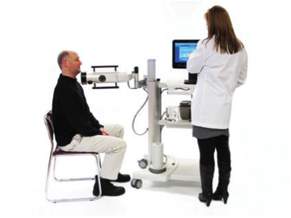
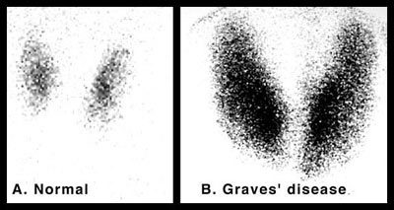
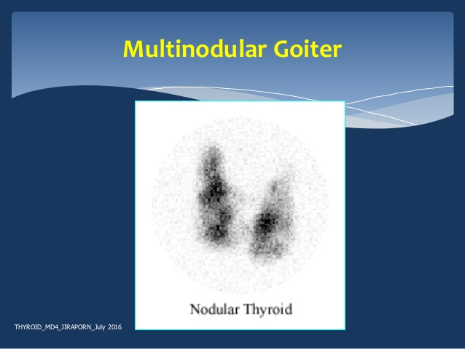

Slide 18
Hypothyroidism
It is the clinical syndrome that results from inadequate secretion of thyroid hormones from the thyroid gland.
There is a strong correlation between the presence of anti-TPOAb or anti-TGAb and the risk of hypothyroidism.
Other risk factors include the postpartum state, family history of autoimmune thyroid disorders, a previous history of head and neck or thyroid surgery, other autoimmune endocrine disorders such as type 1 diabetes and Addison disease.

Slide 19
Causes of hypothyroidism
Primary hypothyroidism:
Autoimmune thyroiditis (Hashimoto disease): autoimmune inflammatory response results in a lymphocytic infiltration of the thyroid gland and its destruction.
Iatrogenic (irradiation, surgery)
Drugs (amiodarone, radiocontrast media, lithium, interferonα, tyrosine kinase inhibitors, sulfonylureas, antiepileptic drugs).
Silent thyroiditis (including postpartum)
Iodine deficiency (including congenital hypothyroidism in newborns)

Slide 20
Causes of hypothyroidism
Secondary Hypothyroidism
Pituitary disease
Hypothalamic disease

Slide 21
Signs & symptoms
Hypothyroidism can affect nearly any tissue or organ in the body.
The most common symptoms, such as fatigue, lethargy, sleepiness, cold intolerance, bradycardia, slow speech and dry skin, are non specific and can be seen with many other disorders.
The classic obvious signs, such as myxedema and delayed deep tendon reflexes, are seen uncommonly now because more patients are screened or seek medical attention earlier.

Slide 22
Symptoms
Patients with mild hypothyroidism may have slight symptoms that progress so slowly ( not noticed easily by the patient or family).
The lack of specific symptoms emphasizes the importance of using serum TSH level.

Slide 23
Mild (Subclinical) Hypothyroidism
It is present when a patient has a TSH above the upper limit of the laboratory reference range but usually below 10 μIU/mL, normal FT4, and no obvious hypothyroid signs.
Some will progress to overt hypothyroidism.
Many patients have mild, nonspecific symptoms (eg, fatigue, cold intolerance, constipation).
Recent studies showed subclinical hypothyroidism to be associated with decreased myocardial contractility, decreased exercise tolerance, (LDL) cholesterol, and neuropsychiatric symptoms.

Slide 24
Complications of hypothyroidism
Hypercholesterolemia, increasing the long-term risk of cardiovascular disease (direct correlation between degree of TSH elevation and rise in serum cholesterol).
Increased systemic vascular resistance, decreased cardiac output.
Neuropsychiatric problems, including a dementia-like state in the elderly.
Maternal hypothyroidism affect fetal development (fetus depends on maternal thyroid hormones for CNS development in the first trimester.

Slide 25
Complications
Myxedema coma is seen in advanced hypothyroidism.
These patients develop CNS depression (confusion or coma)
Respiratory depression
fluid and electrolyte disturbances (hyponatraemia).
Hypoglycemia , hypothermia
Severe cardiac failure
patients require full intensive care
Triggered by factors that impair respiration, pneumonia, congestive heart failure, myocardial infarction, trauma, or administration of CNS depressant drugs.

Slide 26
Complications
Treatment of Myxedema coma
Levothyroxine as IV (300 to 500 mcg ).
Oxygen
Monitoring of cardiac output and pressures
Gradual rewarming
Hydrocortisone
Glucose infusion to prevent hypoglycaemia

Slide 27
Thyroid hormone products Treatment by
They include synthetic LT4 and T3, combinations of synthetic LT4 and T3, and animal-derived products.
LT4 is the treatment of choice for almost all patients with hypothyroidism. It mimics the normal physiology of the thyroid gland, which secretes mostly T4 as a prohormone.
A once-weekly LT4 regimen is safe and effective (long half life)
The greatest bioavailability when taken in the evening on an empty stomach.

Slide 28
Hypothyroidism in children
Congenital hypothyroidism is uncommon, and all newborns undergo screening with a TSH level.
As soon as the hypothyroid state is identified, the newborn should receive the full LT4 replacement dose.
The replacement dose of LT4 in children is age dependent.

Slide 29
Hypothyroidism & pregnancy
During pregnancy, β-human chorionic gonadotropin (β-hCG) acts as a TSH receptor agonist, increasing the amount of thyroid hormone available for fetal growth and development.
Hypothyroid women who become pregnant need an increased dose of LT4, typically 20% to 50% above the prepregnancy dose.
The increased dose should be maintained throughout the pregnancy, with monthly TSH monitoring.
After delivery, the LT4 dose usually can be reduced.

Slide 30
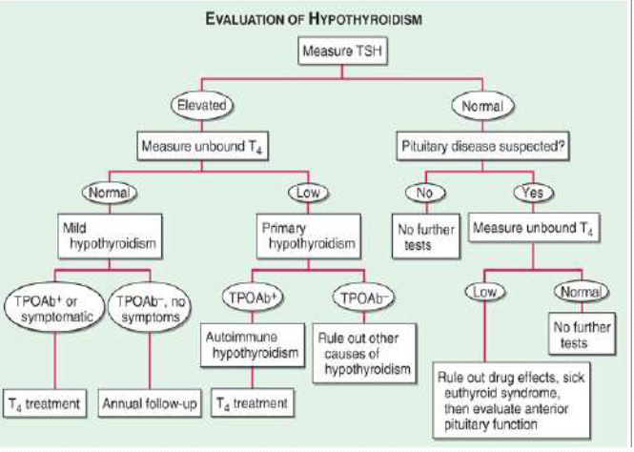

Slide 31
Hyperthyroidism & thyrotoxicosis
It is much less common than hypothyroidism.
Hyperthyroidism is related to excess thyroid hormone secreted by the thyroid gland.
Thyrotoxicosis is any syndrome caused by excess thyroid hormone.

Slide 32
Causes of thyrotoxicosis
Primary Hyperthyroidism
Graves disease
Toxic multinodular goiter
Toxic adenoma
Thyroid cancer
Struma ovarii (monodermal teratoma)
Iodine excess (including radiocontrast, amiodarone)
Notes:
Struma ovarii is a rare ovarian tumor that was first described in 1899. It is defined by the presence of thyroid tissue comprising more than 50% of the overall mass
They are a type of germ cell tumor (a tumor that begins in the cells that give rise to sperm or eggs).^{[4][8]} They are divided into two types: mature and immature.^{[4]} Mature teratomas include dermoid cysts and are generally benign.^{[8]} Immature teratomas may be cancerous

Slide 33
Causes
Thyrotoxicosis without Hyperthyroidism
Subacute thyroiditis
Silent (painless) thyroiditis
Excess thyroid hormone intake
Drug-induced (amiodarone, iodine, lithium, interferons)
Secondary Hyperthyroidism
TSH-secreting pituitary tumors
Trophoblastic (hCG-secreting) tumors
Gestational thyrotoxicosis

Slide 34
Signs & symptoms of Thyrotoxicosis
Appear due to hypermetabolic state and overactivity of sympathetic nervous system.
Weight loss
Increased appetite
Irritability
Tremor
Goiter
Stiffness
Muscle weakness
Breathlessness
Palpitation
Vomiting
Diarrhea
Oligomenorrhoea
Loss of libido
Excessive sweating

Slide 35
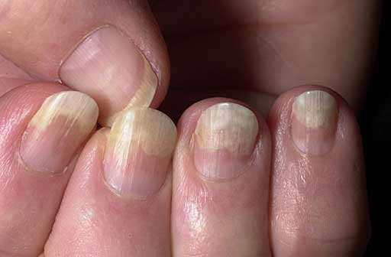
Signs & symptoms
Tachycardia or atrial fibrillation
Systolic hypertension
Depression
Myopathy
Onycholysis
Palmar erythema
Notes:
painless separation of the nail from the nail bed.

Slide 36
Diagnosis
Low TSH level (less than 0.5 μIU/mL) signifies thyrotoxicosis.
FT4 is elevated in overt hyperthyroidism but may be normal in mild hyperthyroidism.
Increased radioiodine uptake in the thyroid indicates increased hormone production by the thyroid gland.
Almost all patients with Graves disease will have +ve TSHR-SAbs and positive anti-TPOAbs.

Slide 37
Mild (Subclinical) Hyperthyroidism
Defined as a low TSH level with a normal FT4 level.
Few or no symptoms.
Some patients progress to overt thyrotoxicosis.
They may experience long-term cardiovascular and bone complications.
Treatment should be considered in patients with TSH levels less than (0.1μIU/mL), Graves disease, postmenopausal women, and patients with cardiovascular disease.

Slide 38
Graves Disease
It is an autoimmune syndrome that includes hyperthyroidism, thyroid enlargement, exophthalmos and other eye findings, and skin findings.
More common in adults -between 20 and 50 years
Hyperthyroidism results from the production of TSHR-SAbs in at least 80% of patients.
These antibodies have TSH agonist activity, thereby stimulating hormone synthesis and release.
They cross-react with orbital and fibroblastic tissue, resulting in ophthalmopathy and dermopathy..

Slide 39
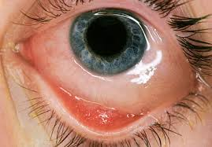
Graves disease
Although the cause of Graves disease is not known, heredity seems to play a role.
Ophthalmopathic changes include exophthalmos, proptosis, chemosis and periorbital edema. Eyelid retraction causes a typical staring.
Patients may complain of vague eye discomfort and excess tearing

Slide 40
Graves disease
In severe cases, the eyelids are unable to close completely, resulting in corneal damage.
In very severe cases, the optic nerve can be compressed leading to permanent vision loss.
Skin findings include hyperpigmented skin, typically over the pretibial area (pretibial myxedema), the dorsa of the feet, and the shoulder areas. Clubbing of the digits (thyroid acropachy) is associated with long-standing thyrotoxicosis.

Slide 41
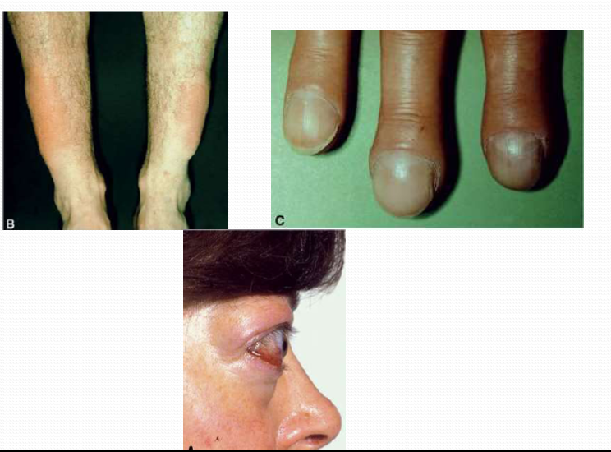
Graves disease

Slide 42
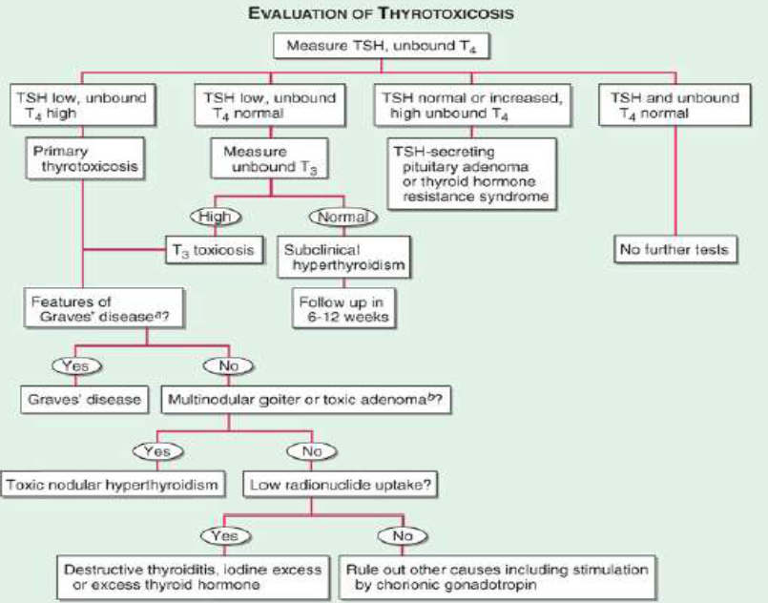

Slide 43
Treatment of thyrotoxicosis
The goals of treating hyperthyroidism are:
Relieve signs and symptoms.
Reduce thyroid hormone production to normal levels.
Prevent long-term complications.

Slide 44
β blockers
Used to rapidly relieve palpitations, tremor, anxiety (many symptoms are mediated by β- adrenergic activity).
Because β-blockers do not reduce the synthesis of thyroid hormones, they are used only until more specific antithyroid therapy is effective.
Because nonselective agents can impair the conversion of T4 to T3, propranolol and nadolol are preferred.
when a contraindication exists, clonidine, verapamil or diltiazem may be used.

Slide 45
Methods to Reduce Thyroid Hormone Synthesis
Excess production of thyroid hormone can be reduced in four ways:
Iodides
Antithyroid drugs
Radioactive iodine
Surgery

Slide 46
Iodide
Large doses of iodide inhibit the synthesis and release of thyroid hormones. Serum T4 levels may be reduced within 24 hours, and the effects may last for 2 to 3 weeks.
They are used most commonly in Graves disease patients before surgery and to quickly reduce hormone release in patients with thyroid storm.
The toxic effects are hypersensitivity reactions, “iodism” (palpitations, depression, weight loss, and pustular skin eruptions), and gynecomastia.

Slide 47
Antithyroid Drugs
The thionamide agents propylthiouracil and methimazole.
They act by interfering with thyroid peroxidase–mediated iodination of tyrosine residues in thyroglobulin .
Propylthiouracil has the added effect of inhibiting the conversion of T4 to T3.
They have immunosuppressant effects (graves disease).
Agranulocytosis is one of the most serious adverse effects
Relapse may occur after stopping the drug use.

Slide 48
Radioactive iodine
Radioactive iodine, typically 131I, produces thyroid ablation without surgery.
131I is well absorbed after oral administration, concentrated in the thyroid gland and has a half-life of 8 days.
Over a period of weeks, thyroid cells taking up the 131I begin to develop abnormalities and necrosis. Eventually, thyroid cells are destroyed and hormone production is reduced.

Slide 49
Radioactive iodine
In most patients, hypothyroidism will develop, and long-term LT4 replacement will be necessary.
Because 131I has a slow onset of action, most patients are treated initially with β-blockers and antithyroid drugs.
Contraindicated during pregnancy and breastfeeding.
May cause a painful thyroiditis, which may necessitate anti-inflammatory therapy.

Slide 50
Surgery
Subtotal thyroidectomy is indicated in patients with very large goiters and thyroid malignancies and those who do not respond or cannot tolerate other therapies.
Patients must be euthyroid before surgery, and they are often administered iodide preoperatively to reduce gland vascularity.
Postoperative hypothyroidism occurs in 10% of patients.
Serum calcium and intact parathyroid hormone levels should be monitored for early identification of postoperative hypoparathyroidism.

Slide 51
Graves disease and pregnancy
Pregnancy may worsen thyrotoxicosis in women with Graves disease due to the TSH agonist effect of β-hCG.
Untreated maternal thyrotoxicosis may result in increased rates of premature delivery, eclampsia.
Fetal and neonatal hyperthyroidism may occur as a result of transplacental passage of TSHR-Sab.
Because radioactive iodine is contraindicated and surgery is best avoided during pregnancy, PTU is considered the treatment of choice
it may be preferable to switch from PTU to MMI for the second, third trimesters and lactation (hepatotoxicity)

